Slide 1
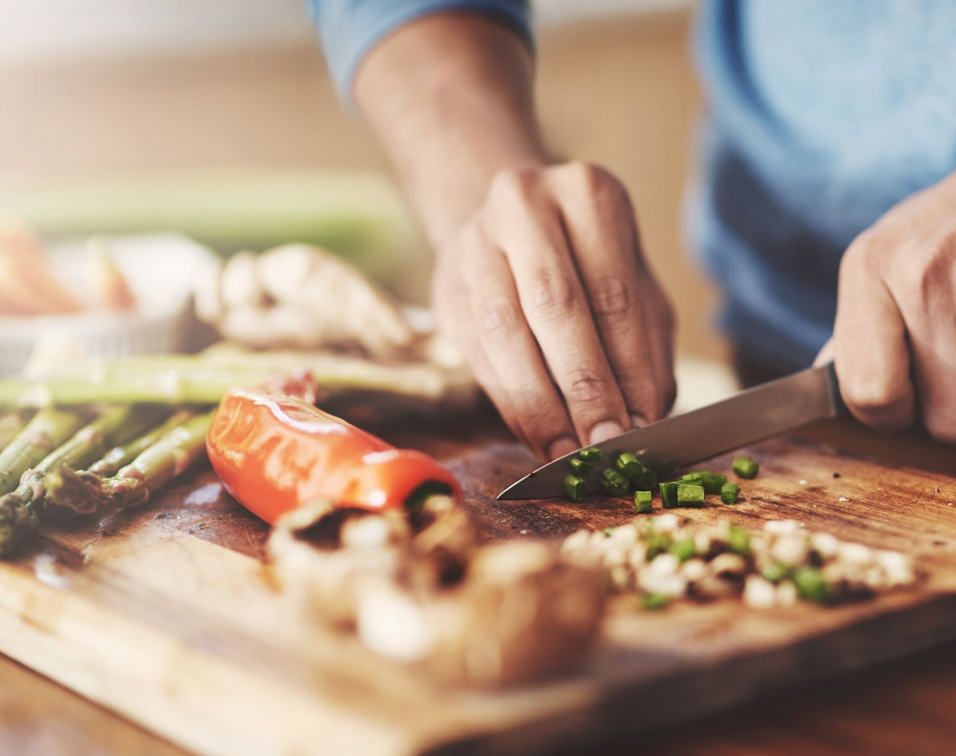
Impact of Data Science in Food Business Data Science As a Field

Slide 2
Agenda
Introduction
Use Cases of Data Science
Organizations
Day to Day of a Data Scientist
Skills Required
Courses at CU Boulder
Analysis

Slide 3
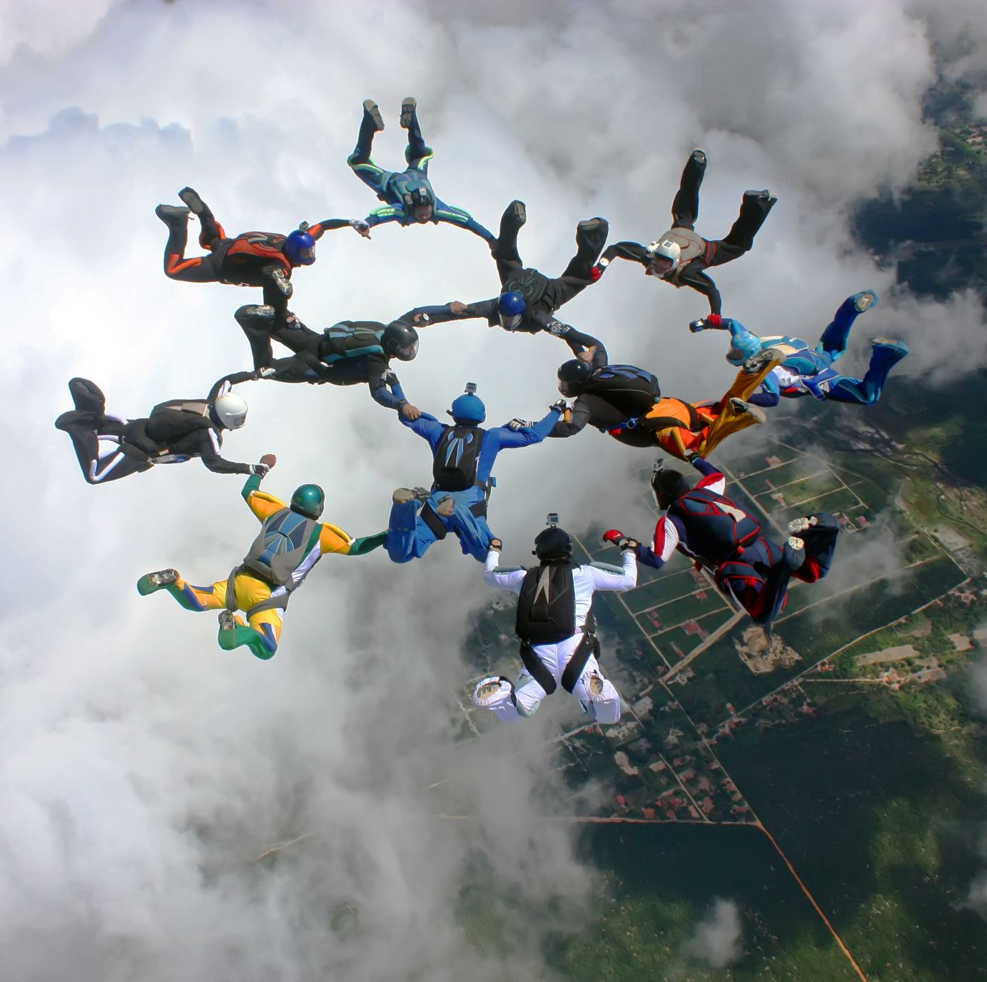
Meet Our Team
Rohith Reddy Peddi
Abhishict Pamula
Gowtham Dasappa
Bhuvanendra Putchala
Sai Srinivasa S P
Venkat

Slide 4
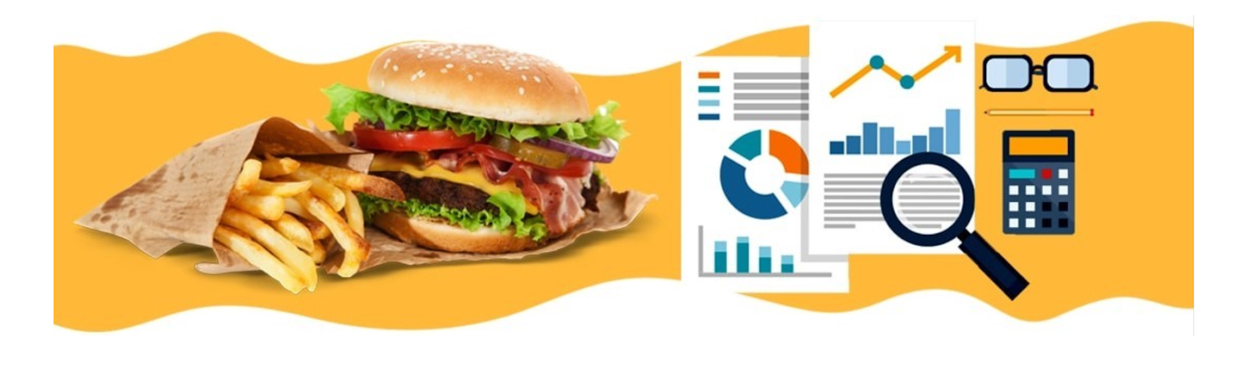
Introduction
The term food industry covers a series of activities like processing, preparation, preservation, packaging and delivery of foodstuffs.
Food manufacturing companies are actively getting deeper into data science to improve inventory management, Meeting quality standards and to meet customer demands.

Slide 5
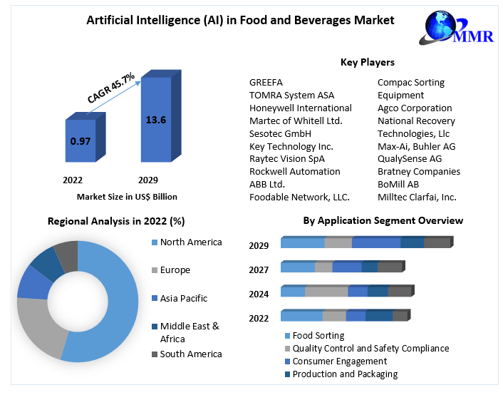
Notes:
Demand for AI software is predicted to increase by 154 % in 2022 compared to the previous year

Slide 6
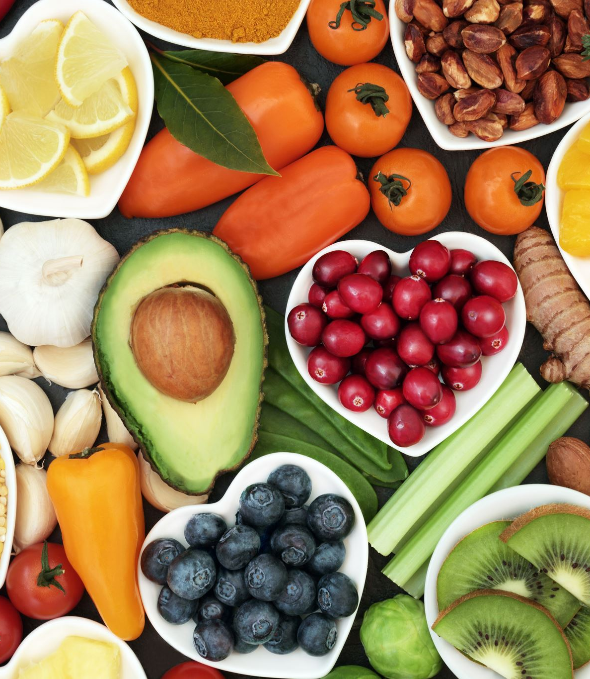
What Goals can Data Science Achieve?
Identifying Trends in Eating Habits
Personalized Recommendations
Forecasting Demand
Inventory Optimization
Feedback Analysis
Improved Insights and Marketing
Notes:
Huge shift in eating habits after Pandemic hit

Slide 7
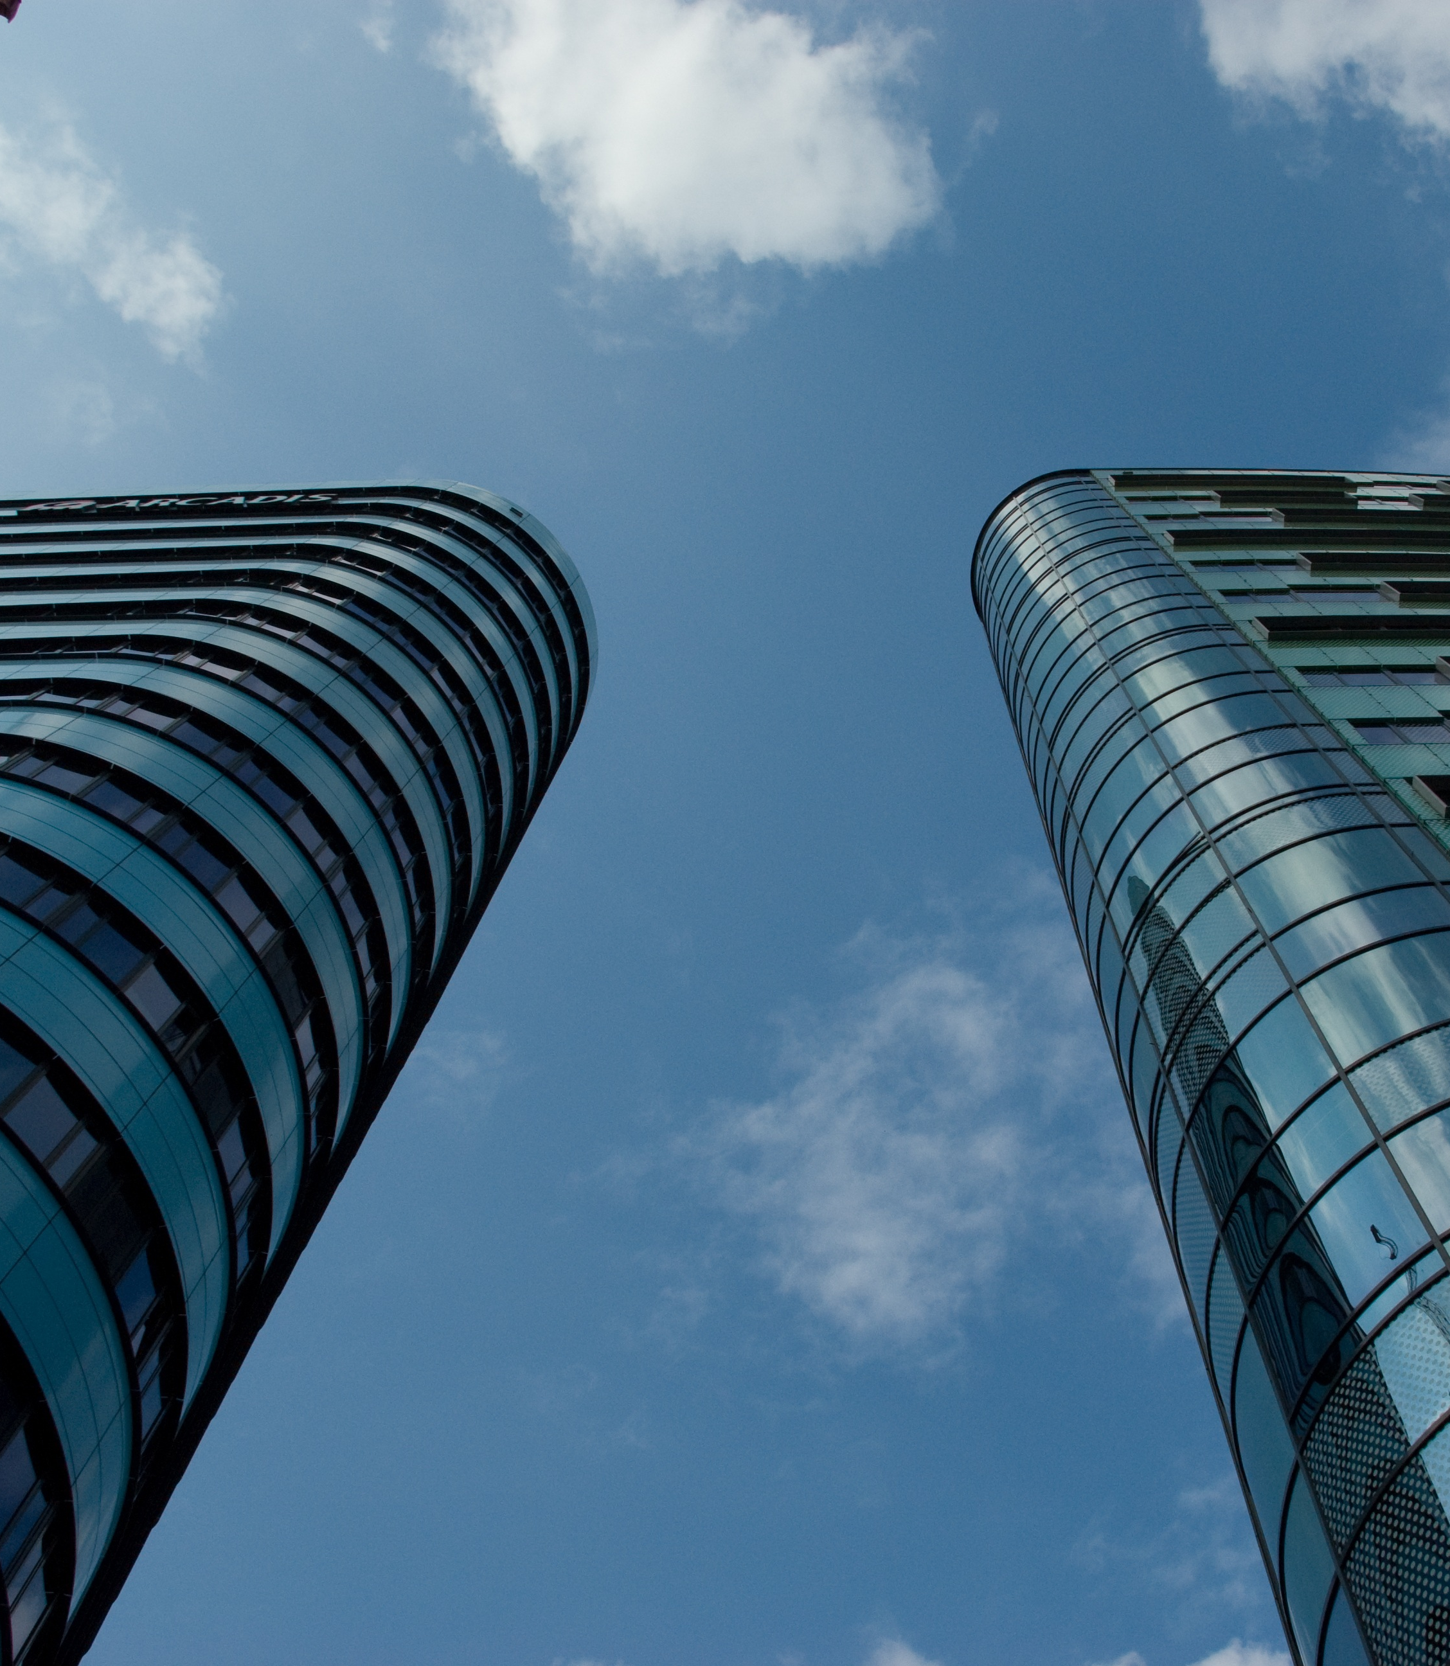
Organizations
The Cheesecake Factory utilizes Big Data-driven software to process and analyze enormous data sets from 175 locations in the U.S.
FreshDirect uses sensors, processing, and analyzing data to monitor product status and environmental conditions during transportation.
McDonald’s uses Big Data to analyze customer feedback and food preferences which enhances customer experience and sales.
MyFitnessPal uses data science to provide personalized recommendations, track progress, and analyze user behavior to improve its features.
UberEats employs recommendation algorithms to suggest restaurants and dishes to users.
Notes:
UberEats uses Michelangelo, a machine learning platform in the United States: UberEats serves more than half of the United States' population, facilitating deliveries for about 100,000 restaurants. It also operates in 300 cities and 300 other places around the world

Slide 8
Day-to-Day of a Data Scientist
Project Planning and Prioritization
Data Analysis
Data Collection and Integration
Data Cleaning and Preprocessing
Exploratory Data Analysis (EDA)
Building Models
Model Development
Model Validation and Testing
Data Visualization
Customer Insights
Creating dashboards & reports
Collaboration
Adapt to New Technologies

Slide 9

Skills Required
Domain Knowledge
Database Management
SQL
ETL
Cloud Services
Model Building
Python/R
Machine Learning
Big Data
Natural Language Processing
Data Visualization
Tableau/Power BI

Slide 10
Courses Offered at CU Boulder
CSCI 6502 Big Data Analytics: Systems, Algorithms, and Applications
CSCI 5622 Machine Learning
CSCI 5832 Natural Language Processing
MSBX 5310 Customer Analytics

Slide 11

Analysis: Understanding Food Choices from a Comprehensive Student Survey
Data was collected by Ms. Bora Pajo during her time as an assistant professor at Mercyhurst University in Erie, Pennsylvania.
She surveyed 126 students regarding their food and eating choices. The survey includes 55 questions where the students self-reported their eating habits, food preferences and spending behavior.
Columns Used for Analysis: Student Year, Place of Residence, How much are students willing to pay when they eat out, How often do they eat out, Ideal Diet according to them and Favourite Cuisine

Slide 12
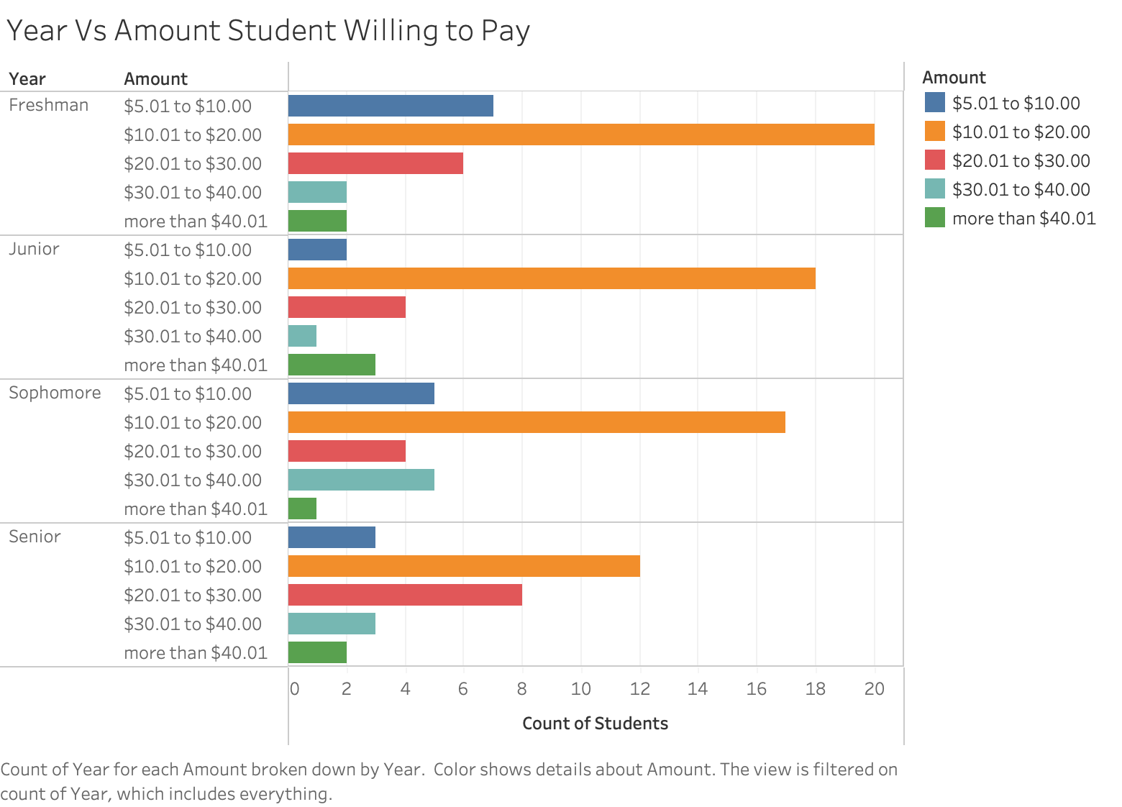
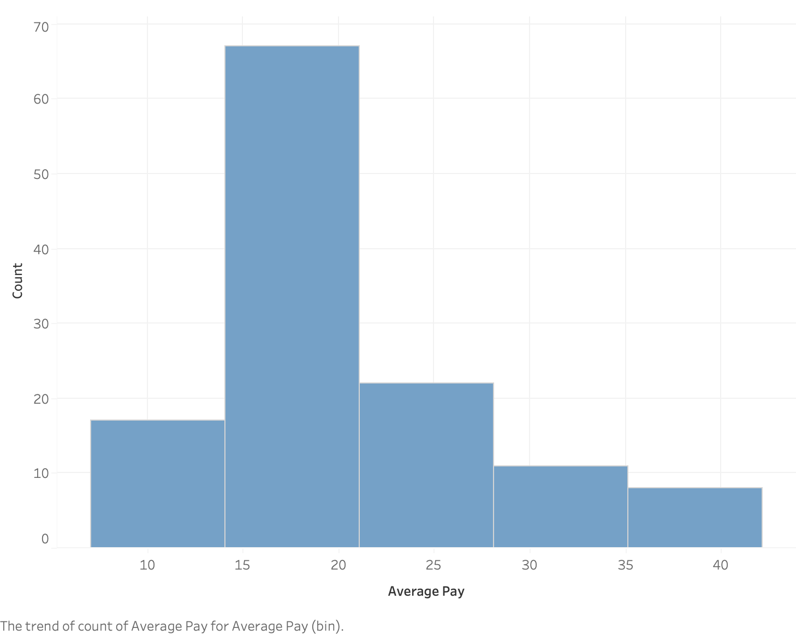
How much do you want to pay for a meal out?
$15-$20

Slide 13
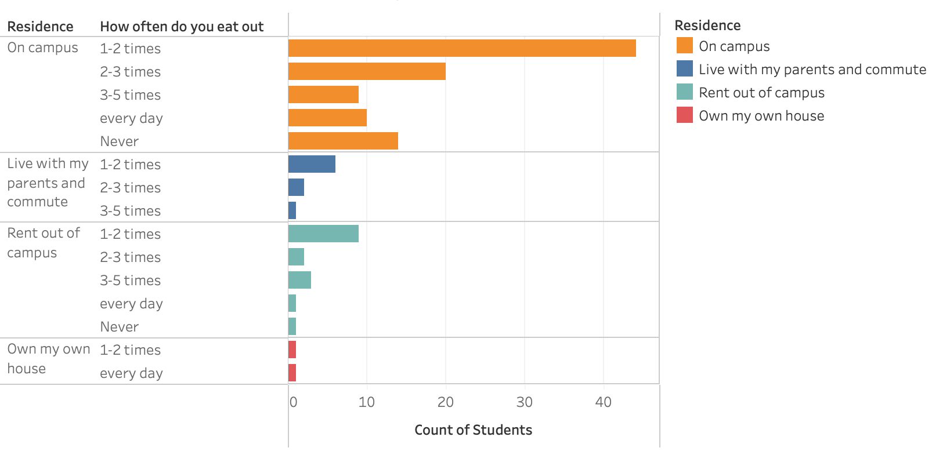
Place of Residence & How Often do the Students Eat Outside

Slide 14
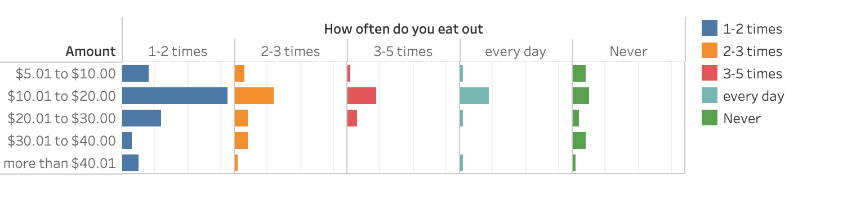
Amount Students Willing to Pay & How Often do the Students Eat Outside

Slide 15
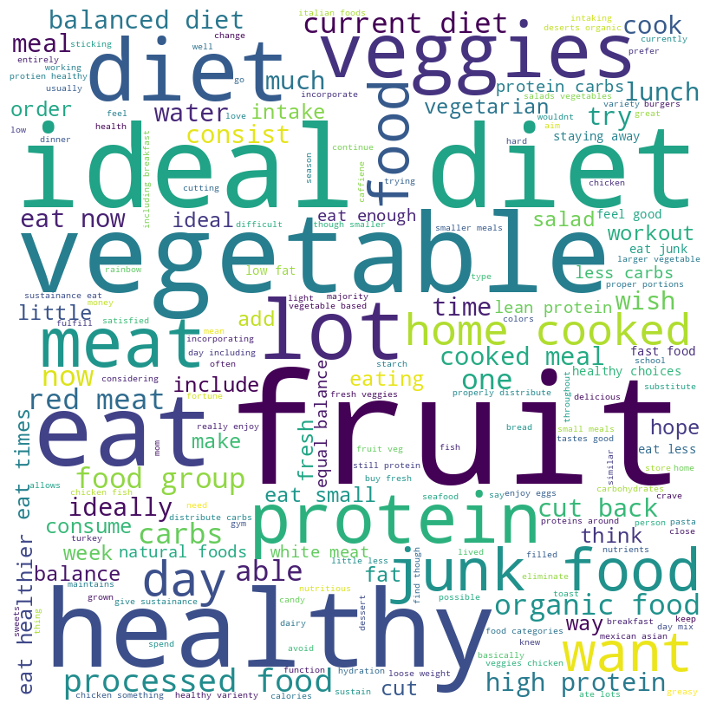
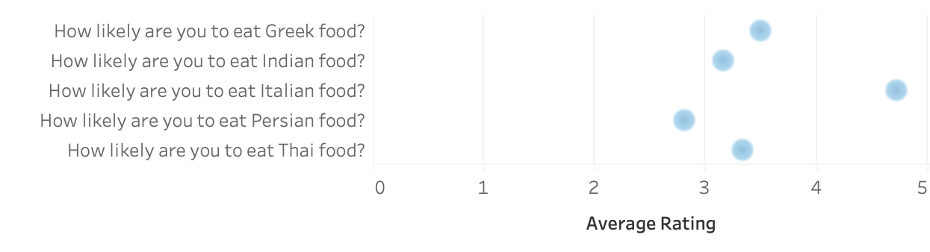
Favourite Cuisines
Pasta, Steak, Chicken, Pizza, Spaghetti and Lasagna are the most desirable food items that the students are willing to have.
Ideal Diet for Students

Slide 16
References:
https://github.com/bora-pajo/Food
https://www.maximizemarketresearch.com/market-report/artificial-intelligence-ai-in-food-and-beverages-market/107511/

Slide 17
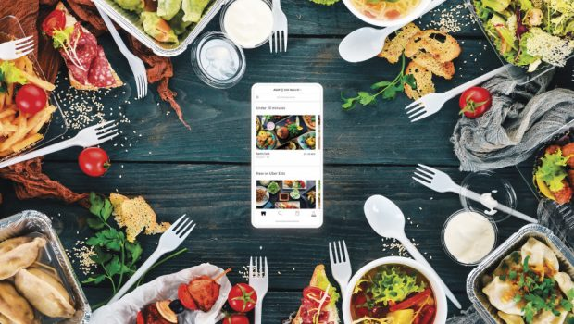
THANK YOU
This Photo by Unknown author is licensed under CC BY-SA-NC.

